Slide 1
BANKING APPLICATION
PROJECT GLADIATOR- LTI BANK
TEAM MEMBERS:
Rithik Gujar (Team Lead) (10684052)
Ankit Basrur (10683753)
Ayushi Agrawal (10683928)
Chandni Panjabi (10684246)
Kunal Verma (10683308)
PROJECT MENTOR:
Mr Aneesh C P

Slide 2
ABOUT THE PROJECT
Online banking system is specifically developed for internet banking for balance enquiry, funds transfer to another account, change of profile information and account statement. The traditional way of maintaining details of a user in a bank was to enter the details and record them. Every time the user needs to perform some transaction they have to go to bank and perform the necessary actions, which may not be so feasible all the time. Here, we provide an automation for banking system through Internet. The aim is not only automation but also a better customer experience by providing a User Interface which is easily comprehensible by any person. The website should also provide customer support so that the users get responded to their queries immediately and maintain the transparency so that the users should be aware of all the charges associated with the transaction.

Slide 3
TOOLS AND SOFTWARE USED
Tools Used
Angular CLI 12.2.0
Spring Tool Suite 4
Oracle 11g Express Edition
Oracle SQL Developer 19.2.1
Bootstrap 4.0.0
SMTP protocol
Angular Material UI
Spring Boot v2.5.3
Github
Technologies Used
Spring Rest
Spring JPA
HTML
CSS
DBMS
Git
Rest API

Slide 4
MODULES
USER MODULE
Home page
Open an account
Register
Login
Forgot user ID
Forgot password
ADMIN MODULE
Login
Approve Account Creation
DASHBOARD
Dashboard page
Account Details
Account Summary
Account Statement
Change Password
Fund Transfer
Session Expired

Slide 5
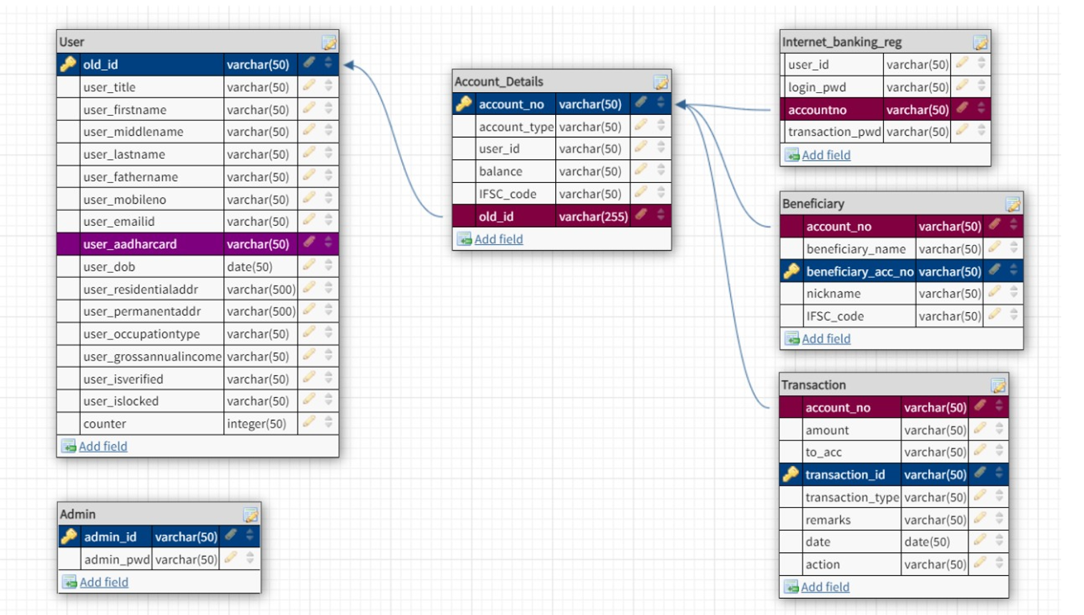
ER DIAGRAM
Blue - Primary key , Maroon - Foreign key
SCRUM BOARD
https://docs.google.com/spreadsheets/d/1uX13raKQrJ-4sKZRbx6wke3k4SEPXVedyoi5VwgBei8/edit#gid=0

Slide 6
FLOW OF MODULES
USER MODULE
After visiting LTI Bank’s home page, user will see navigation bar which includes
About us section in which there is information about our bank
Contact us section in which user can contact us for any query
Profile section which includes
Admin login
User login
Register for Net Banking
Open Account

Slide 7
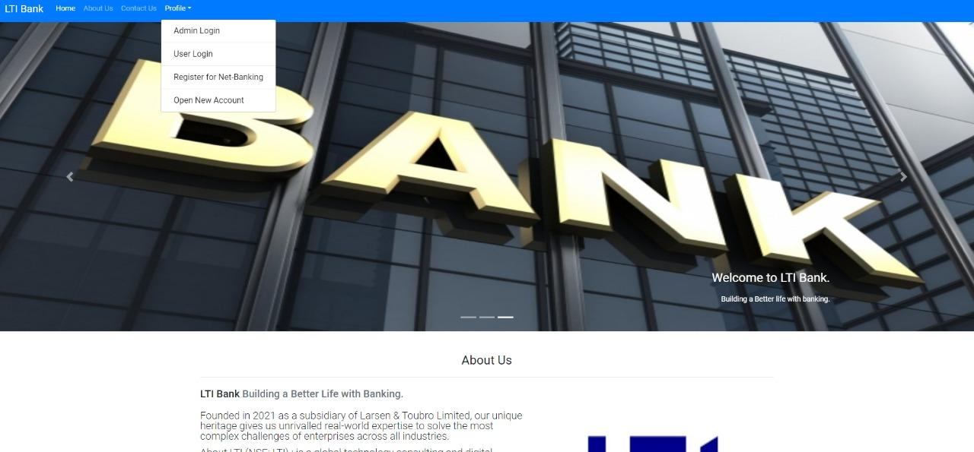
FLOW OF MODULES
User Module – Home Page

Slide 8
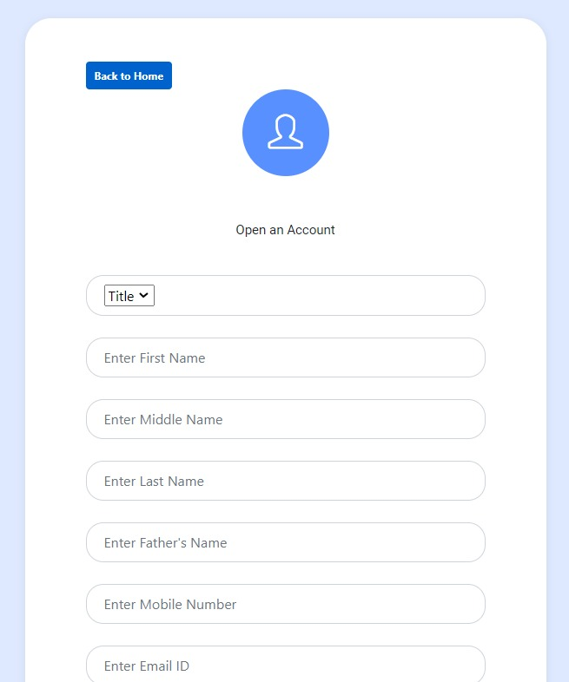
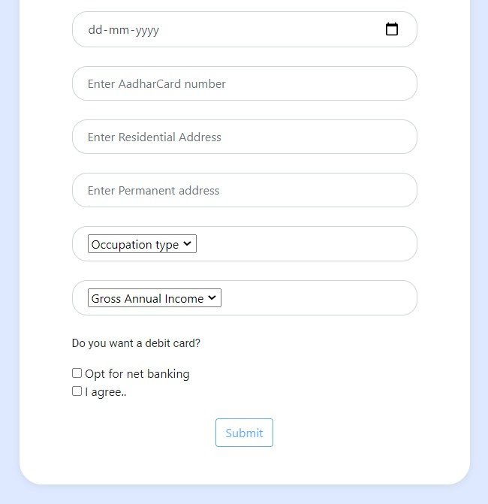
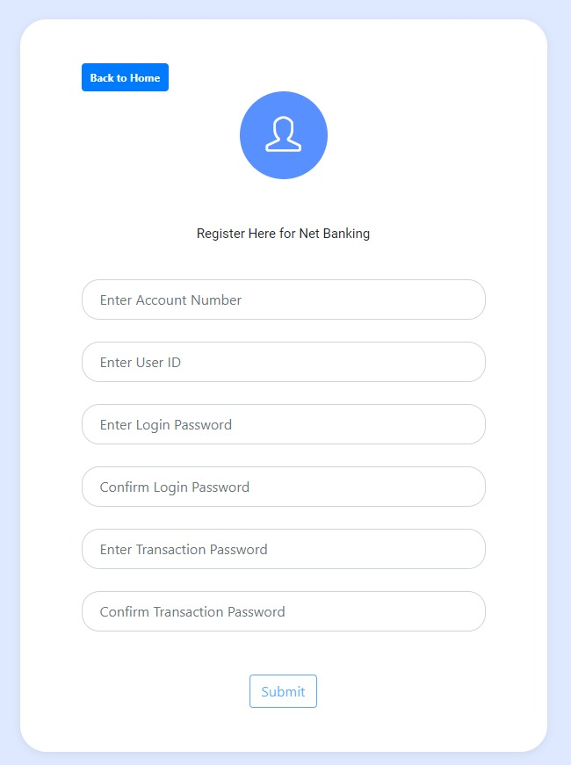
FLOW OF MODULES
USER MODULE- OPEN AN ACCOUNT AND REGISTER

Slide 9
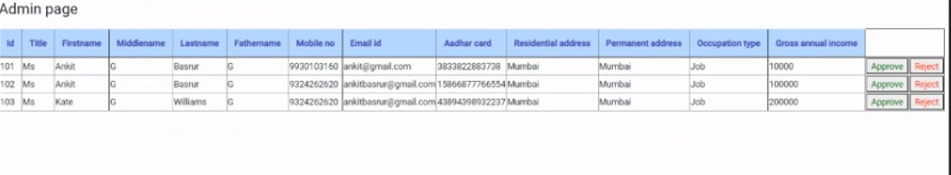
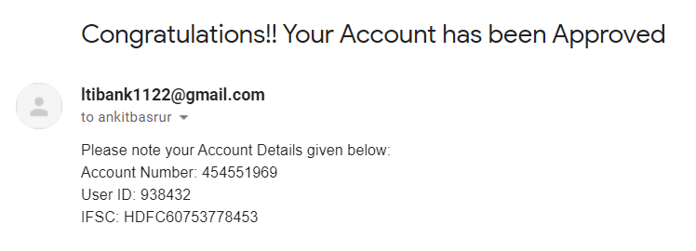
FLOW OF MODULES
After approval by admin, user will get these details in email

Slide 10
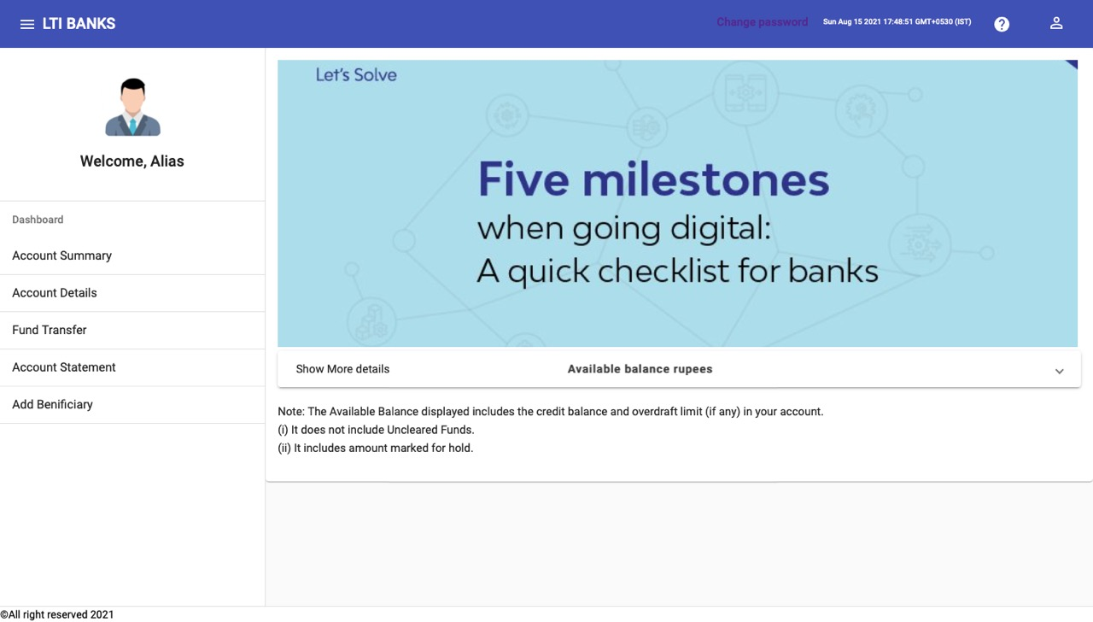
FLOW OF MODULES
Firstly the user has to login into his/her LTI Bank Account, after this step is done, the user will be redirected to Dashboard page which includes various functions as follows:
Account Summary
Account Details
Fund Transfer
Account Statement
Add Payee
Session Expired
Change Password

Slide 11
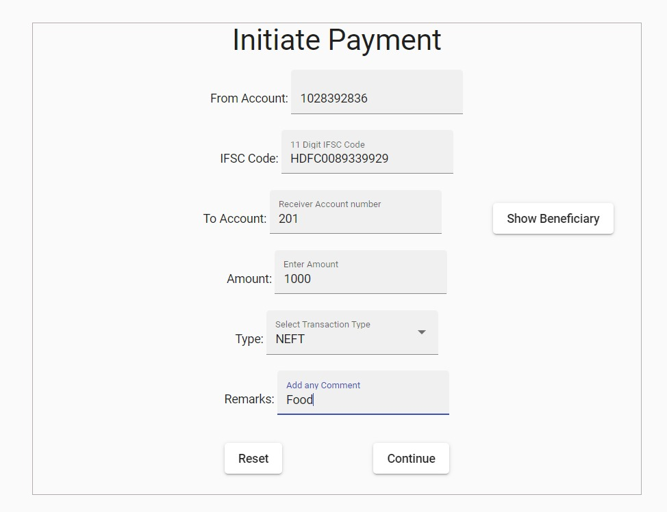
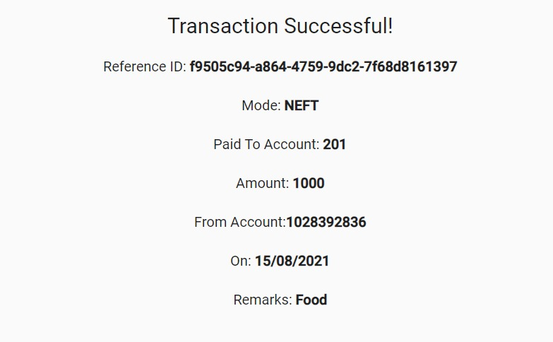
FLOW OF MODULES
Dashboard - Fund Transfer

